Slide 1


Bapuji Institute Of Engineering & Technology Davanagere, Karnataka-577004
DEPARTMENT OF COMPUTER SCIENCE & ENGINEERING
AN INTERNSHIP PRESENTATION
ON
“Working on Hadoop Cluster and DevOps”
A Case Study – Employee Database Payroll Management System
TEAM MEMBERS:
Jeevan H K (4BD20CS040)
Nitish S M (4BD20CS064)
Shrikar H M (4BD20CS090)
Darshan A Hiremath(4BD20CS124)
HEAD OF DEPARTMENT
Dr. Nirmala C R _{Ph.d.}
Prof and Head of Department CS&E
INTERNSHIP GUIDES:
Prof. Waseem Khan _{M.Tech.,}
Assistant Professor
Department of CS&E,
B.I.E.T., Davanagere
Mr. Santhosh Navale,
Ex-Huawei|Freelance Trainer
Bangalore
INTERNSHIP CO-ORDINATOR
Dr. Abdul Razak M S_{Ph.d.}
Associate Professor
Department of CS&E,
B.I.E.T., Davanagere

Slide 2
CONTENTS
Abstract
Introduction
Tasks Performed
System Requirements
Methodology
Results
Conclusion

Slide 3
ABSTRACT
Agile is a method of software development that aims to deliver functional software consistently through brief iterations. Employee Database Payroll Management System project is implemented in terms of agile to deliver in sprints. The project involved the creation of a continuous integration and continuous deployment pipeline for Employee Database Payroll Management System . The pipeline included various stages such as code compilation, testing, packaging, and deployment. The pipeline was implemented using popular DevOps tools such as Git, Jenkins and Cypress. To ensure the quality of Employee Database Payroll Management System , several automated tests were integrated into the pipeline using Cypress. These tests included unit tests, integration tests and acceptance tests. The pipeline was also configured to trigger automatic builds and deployments whenever changes were made to the source code repository. The project the benefits of DevOps practices improving the software development and deployment process.

Slide 4
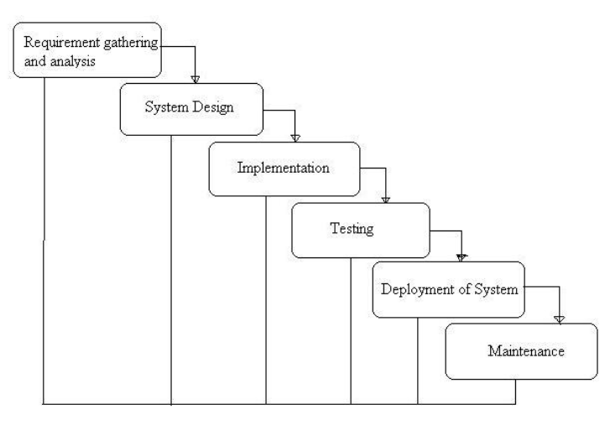
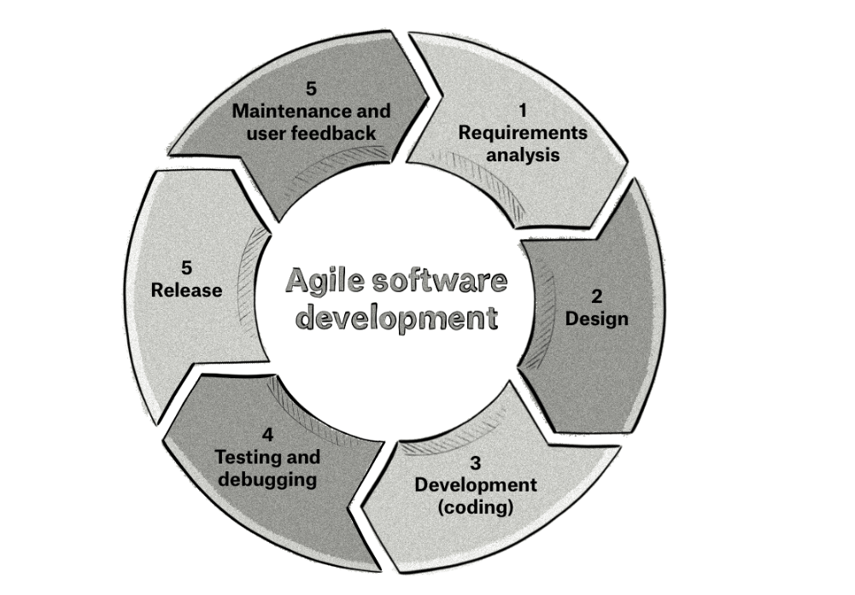
WATERFALL MODEL
It is a linear application development model that uses rigid phases: When one phase ends, the next begins. Steps occur in sequence, and, if unmodified, the model does not allow developers to go back to previous steps
AGILE MODEL
Agile methodologies are iterative and incremental, which means it’s known for breaking a project into smaller parts and adjusting to changing requirements. They prioritize flexibility, collaboration, and customer satisfaction.

Slide 5
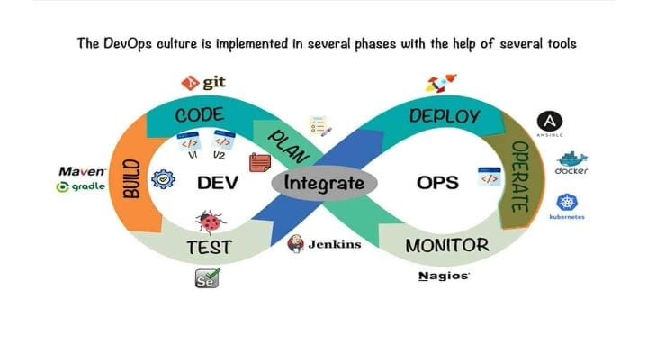
DevOps CONTENTS AND IMPLEMENTATION
DevOps is a combination of software development (dev) and operations (ops). It is defined as a software engineering methodology which aims to integrate the work of development teams and operations teams by facilitating a culture of collaboration and shared responsibility.

Slide 6
TASK PERFORMED
Task Performed During Week 1 :
Tasks included learning about both waterfall and agile software lifecycle methods and creating requirement lists for the “Employee Database Payroll Management System " project accordingly. Additionally, product backlogs were established based on master requirement lists, with sprint backlogs derived using the same template. Furthermore, activities encompassed understanding and implementing normalization and denormalization techniques for the database tables of the Employee Database Payroll Management System .
Task Performed During Week 2:
Tasks encompassed sprint planning and user story creation in Trello, setup of local and cloud environments with XAMPP and Cypress for testing, and learning CI/CD processes with Jenkins for database preparation and automation script execution, alongside handling customer change requests using Git and Jenkins, and utilizing WinSCP and PuTTY for remote server connections.

Slide 7
Task Performed During Week 3:
Involved analyzing requirements and designing for the Employee Database Payroll Management System, setting up version control with Git, including installation via TortoiseGit and executing commands. Additionally, tasks encompassed creating a repository, committing code for the Employee Database Payroll Management System, and preparing a Hadoop cluster with HDFS and Hive for data operations.
Task Performed During Week 4:
System testing involved manual execution of test cases and subsequent automation using Cypress, with submission of test reports. Additionally, tasks included implementing customer change requests, conducting requirement analysis, and designing solutions. Furthermore, setup and installation of Spark, HBase, and Power BI were performed, with Power BI utilized to generate reports for the DBMS project.

Slide 8
SYSTEM REQUIREMENTS
Hardware Requirements
Processor: Intel 5th generation(i5)
Ram: 8GB
Storage: 250GB SSD
System Type: X64-based Processor
Software Requirements
Operating System: Windows 10(or higher)

Slide 9

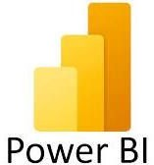
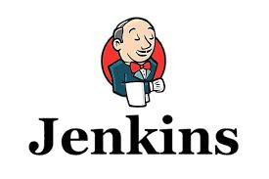
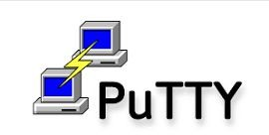

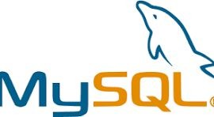

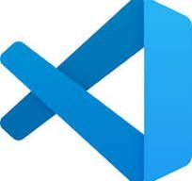


TOOLS IDENTIFIED
Git & GitHub
Trello
VS Code
Jenkins
Cypress
XAMPP
MySQL

Slide 10
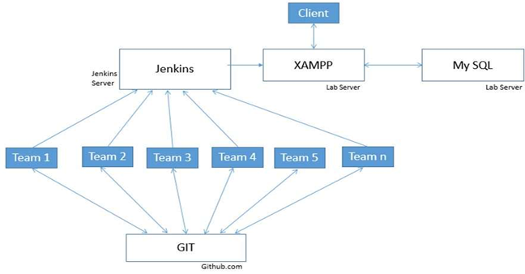
SYSTEM DESIGN
System Topology

Slide 11
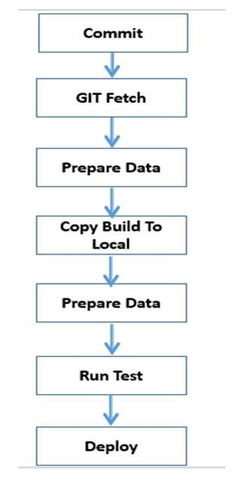
FLOW DIAGRAM

Slide 12
METHODOLOGY
Description of the project work
The main objective of the project is to know fundamental concepts and can work on Agile methodology and DevOps frameworks
To accomplish this, we have to complete the activities and tasks like requirement analysis, User Story creation, Story Board on Trello, and Write automation tests in Cypress, create projects in Jenkins.

Slide 13
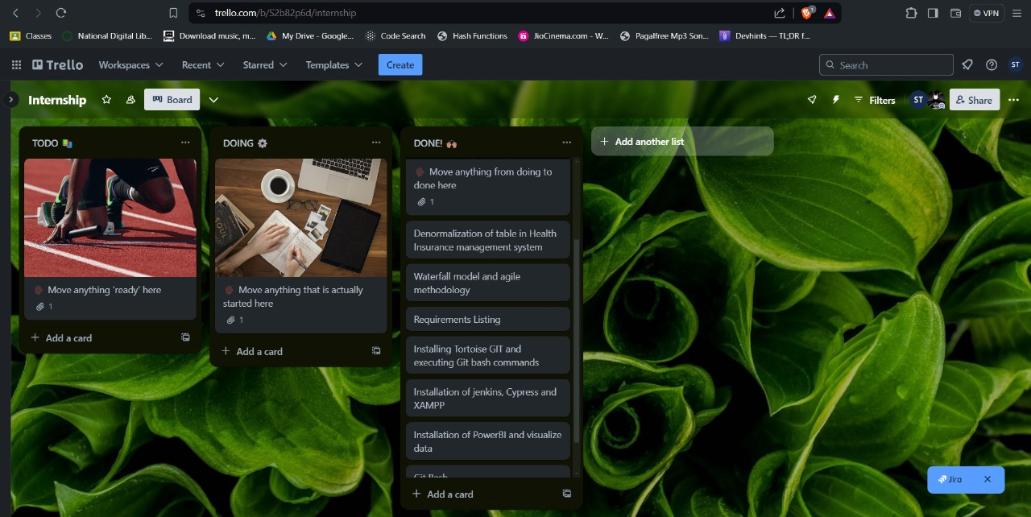
TRELLO
Trello is widely known for being one of the easiest project management tools to pick up and start using.

Slide 14
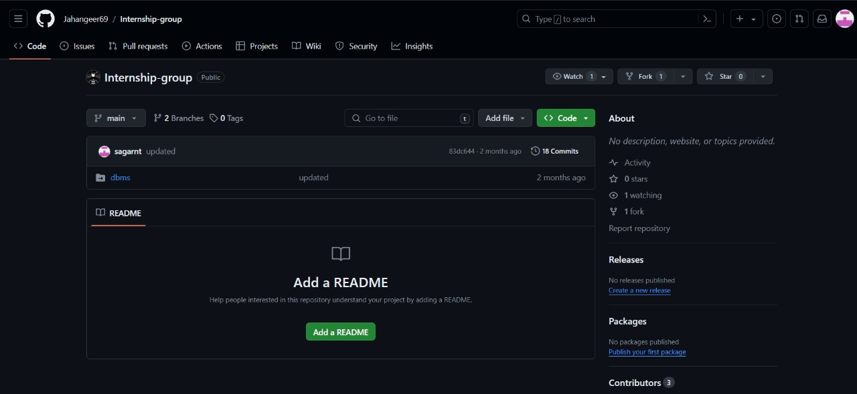
GitHub
XAMPP: Provides a local development environment for testing and debugging the Employee Database Payroll Management System .
MySQL: Utilized as a relational database management system for storing and managing data within the Employee Database Payroll Management System, compatible with cloud-based deployments and DevOps practices.

Slide 15
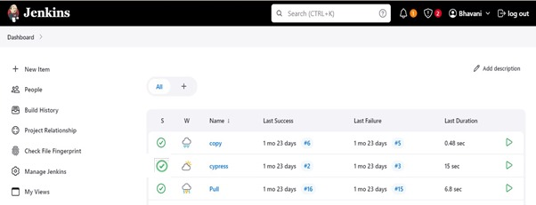
JENKINS
Jenkins is an open-source automation server widely used for continuous integration and continuous delivery (CI/CD) processes in software development. It allows developers to automate the building, testing, and deployment of their applications. Jenkins provides a user-friendly interface for creating and managing pipelines

Slide 16
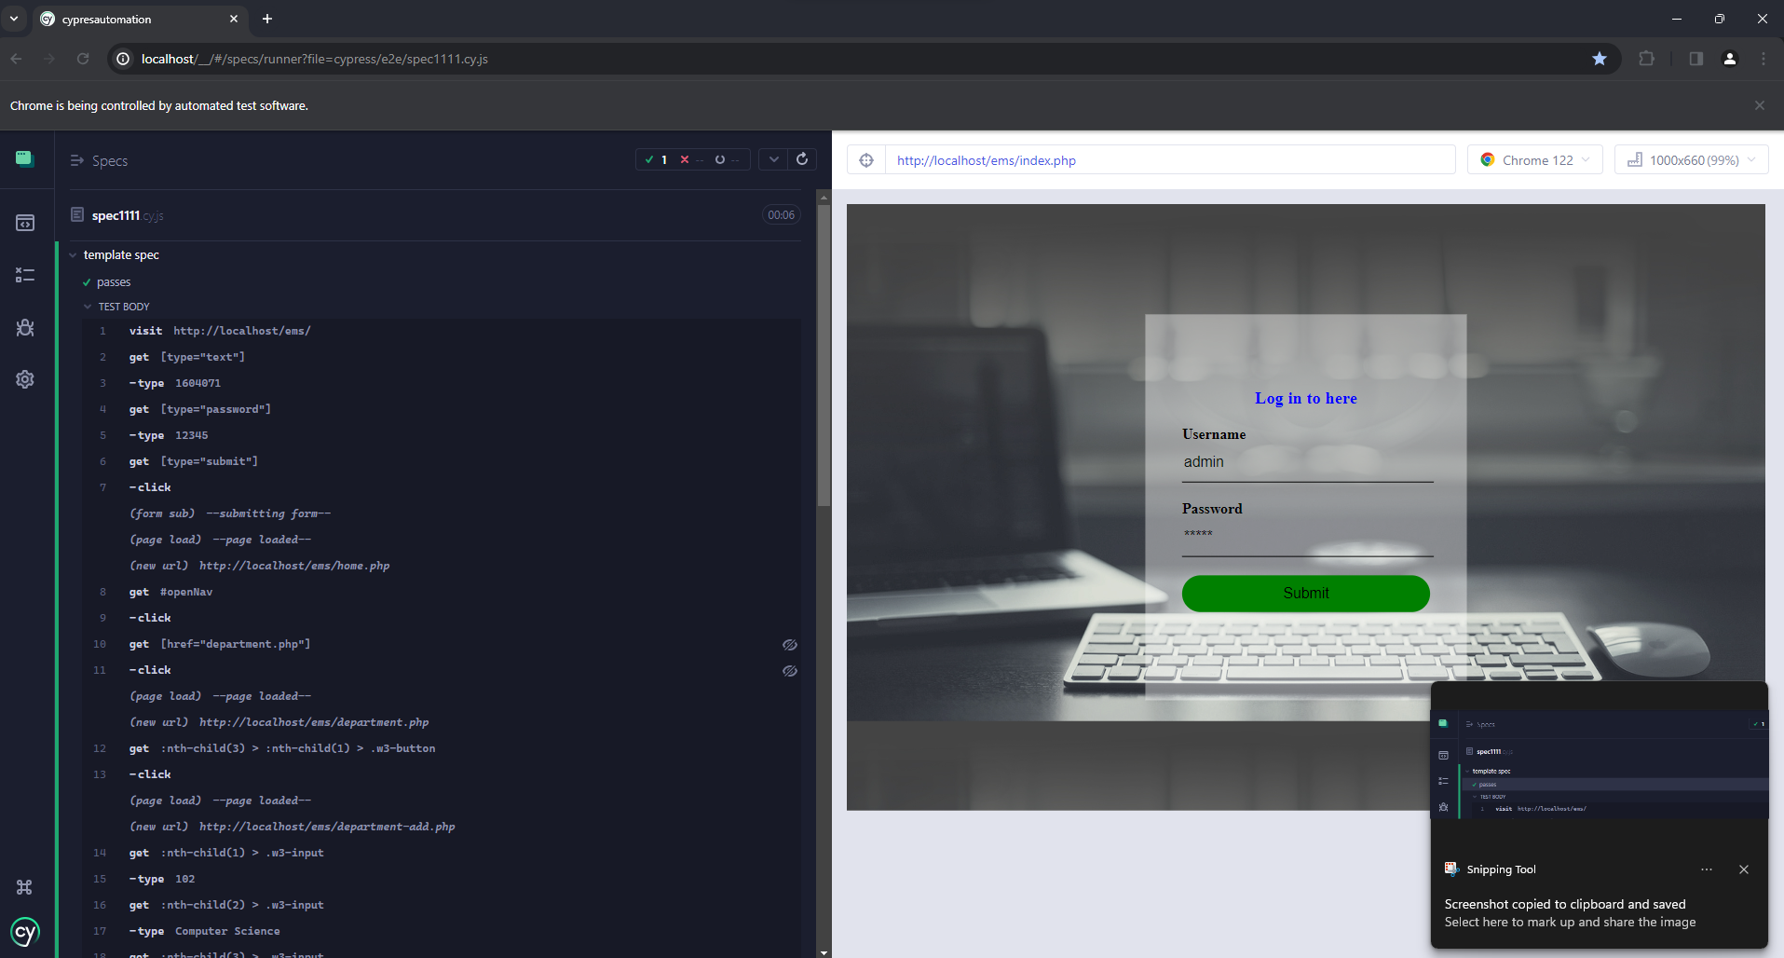
CYPRESS
Cypress is an open-source end-to-end testing framework used primarily for web applications. It allows developers to write automated tests that simulate user interactions with the application, such as clicking buttons, filling out forms, and navigating through pages. It is known for its simplicity, speed, and reliability, making it a popular choice for testing modern web applications.

Slide 17
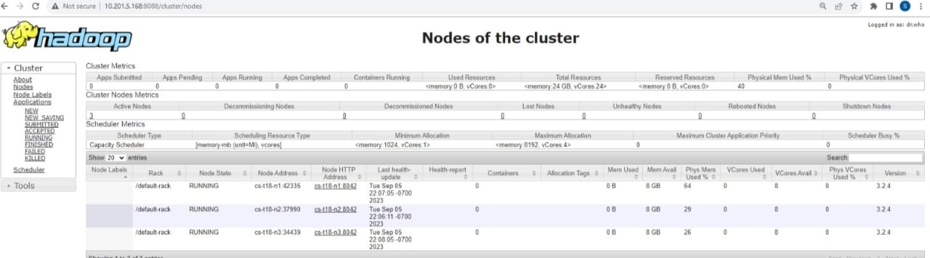
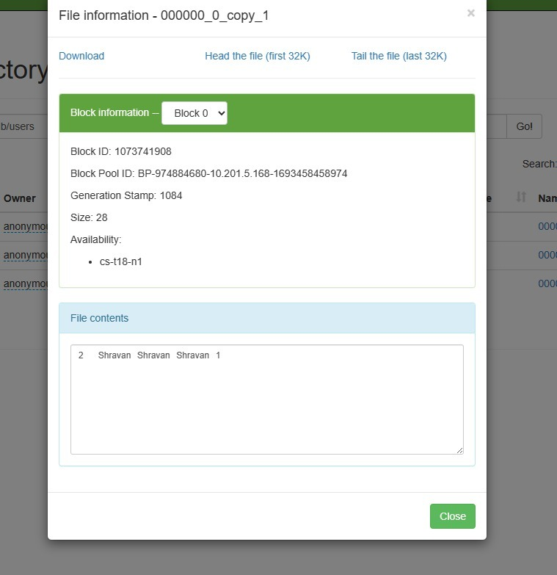
HADOOP ENVIRONMENT
HDFS
1 Data Distribution
2 Fault Tolerance
3 Parallel Processing
4 Scalability
HIVE
Hive is an open-source data warehouse infrastructure built on top of Hadoop for querying and analyzing large datasets stored in Hadoop's distributed filesystem (HDFS). It provides a high-level interface called HiveQL, which is similar to SQL (Structured Query Language), allowing users to write queries to extract, transform, and analyze data stored in Hadoop.

Slide 18
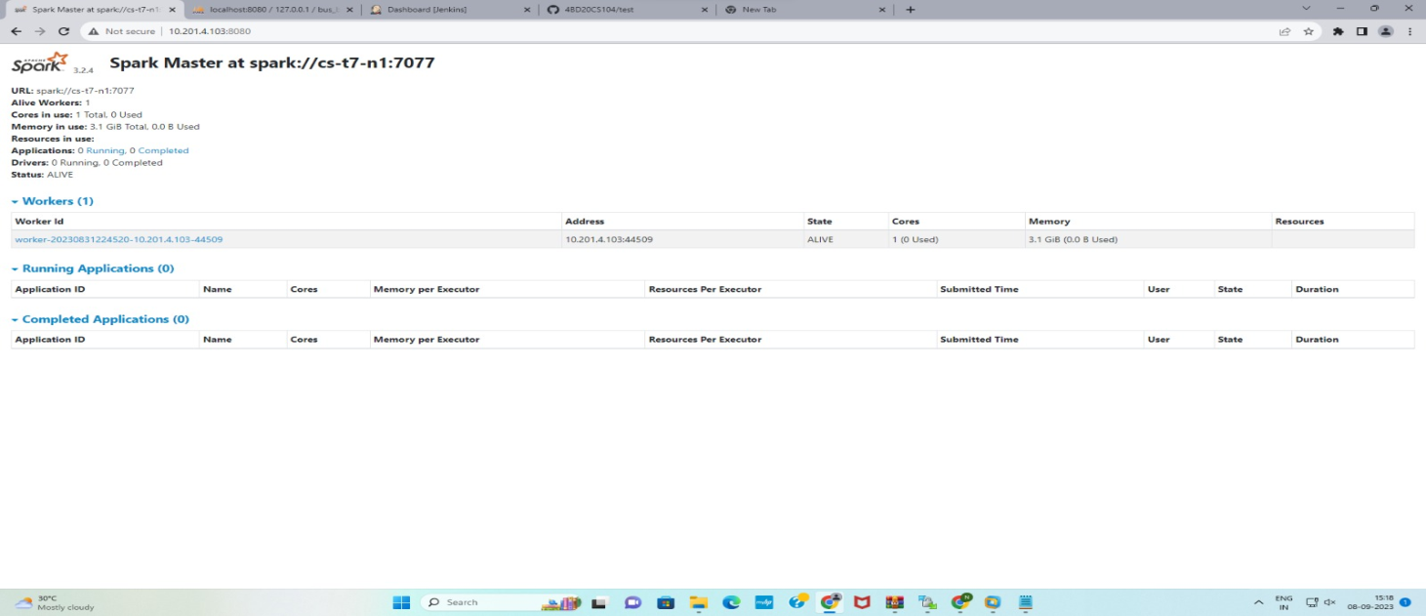
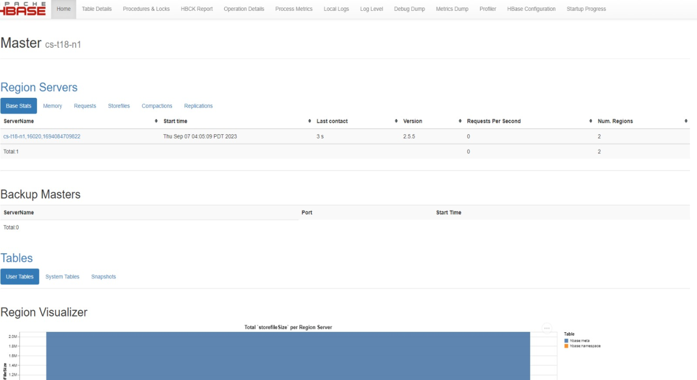
SPARK
Apache Spark is a fast and general-purpose cluster computing framework for big data processing. It's often used in conjunction with Hadoop, but it's not limited to Hadoop and can run independently.
Spark provides in-memory processing for large-scale data processing, making it significantly faster than traditional MapReduce.
HBASE
HBase is a distributed, scalable, and NoSQL database that runs on top of the Hadoop Distributed File System (HDFS). It is designed for providing random, real-time read and write access to large datasets. HBase is particularly well-suited for handling sparse data and is often used in scenarios where quick and random access to data is crucial.

Slide 19
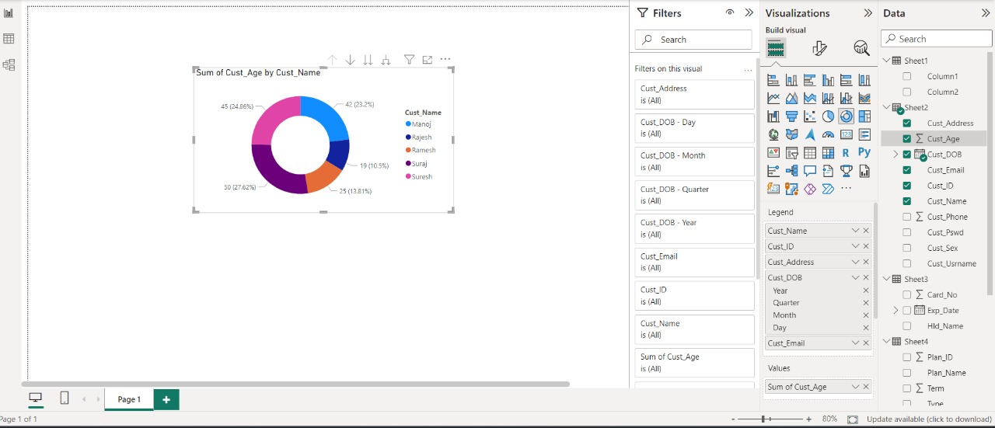
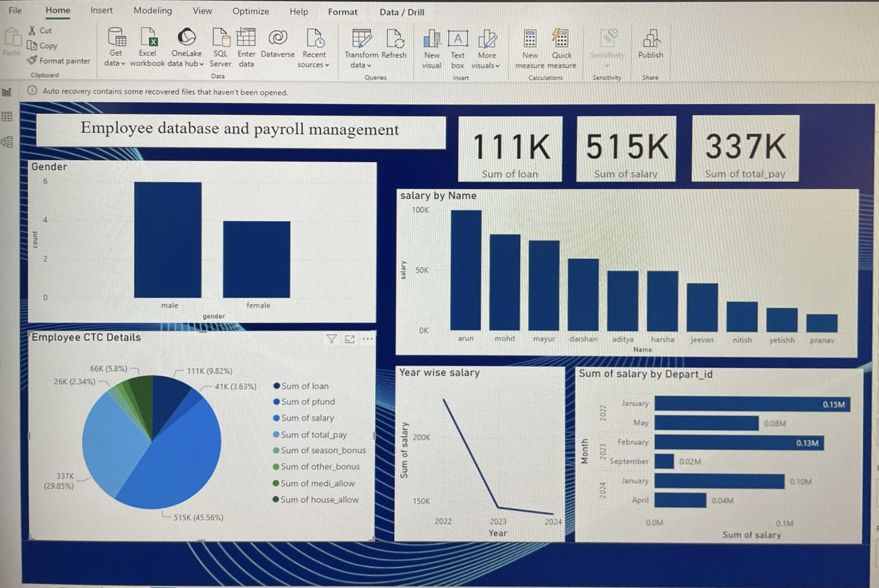
POWER BI
Power BI is a business analytics tool developed by Microsoft that enables users to visualize and analyze data from various sources. It provides a suite of features for data preparation, data modeling, visualization, and collaboration, allowing users to create interactive and insightful reports and dashboards.

Slide 20
CONCLUSION
During the internship, a DevOps team embraced Agile methodologies and DevOps principles, emphasizing rapid and secure software delivery through collaboration and automation. Through projects like the DBMS Project of the Employee Database Payroll Management System project, the team gained hands-on experience in CI/CD processes. Agile and DevOps methodologies streamlined development cycles in the Employee Database Payroll Management System project, resulting in an efficient online Employee Database Payroll Management.

Slide 21
THANK YOU

